Slide 1

6th Grade Math
Unit 12, Lesson 12 Solving One-Step Multiplication and Division Equations Algebraically Volume 2, pg. 346

Slide 2


Benchmark
MA.6.AR.2.3
Write and solve one-step equations in one variable within a mathematical or real-world context using multiplication and division, where all terms and solutions are integers.
volume 2, pg. 346

Slide 3
Integrated Mathematical Thinking and Reasoning Standards
MA.K12.MTR.1.1 Actively participate in effortful learning both individually and collectively.
MA.K12.MTR.2.1 Demonstrate understanding by representing problems in multiple ways.
MA.K12.MTR.4.1 Engage in discussions that reflect on the mathematical thinking of self and others.
MA.K12.MTR.5.1 Use patterns and structure to help understand and connect mathematical concepts.
volume 2, pg. 346

Slide 4

Learning Target
I can solve one-step multiplication and division equations in one-variable algebraically.
volume 2, pg. 346

Slide 5

Warm-Up
volume 2, pg. 346

Slide 6
12.12.1 Warm-Up: Different Problems, Same Solution
Write four equations whose solutions are all $x=3$.
volume 2, pg. 346

Slide 7

Guided Instruction
volume 2, pg. 347

Slide 8

12.12.2 Guided Instruction: Using Inverses to Solve Equations
Inverse operations are used to solve equations by isolating a variable of interest.
When solving one-step equations using visual models, the inverse operation performed on one side of the model is also performed on the other side to keep the equation balanced.
volume 2, pg. 347

Slide 9
With your partner, re-visit the meaning of balanced equations. Write a brief summary explaining what it means for equations to be balanced and how balance is maintained when solving. Include examples as part of your summary.
volume 2, pg. 347

Slide 10
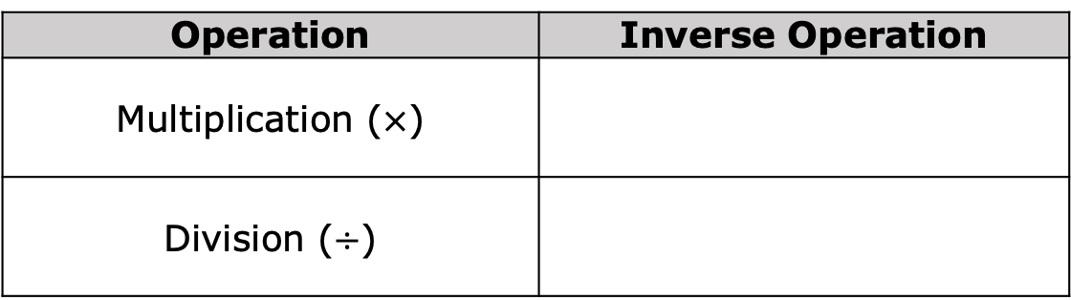
Using the definition of inverse operations, complete the table to indicate which operation would reverse the given operation.
Operation | Inverse Operation
Multiplication ($×$)
Division ($÷$)
volume 2, pg. 347

Slide 11
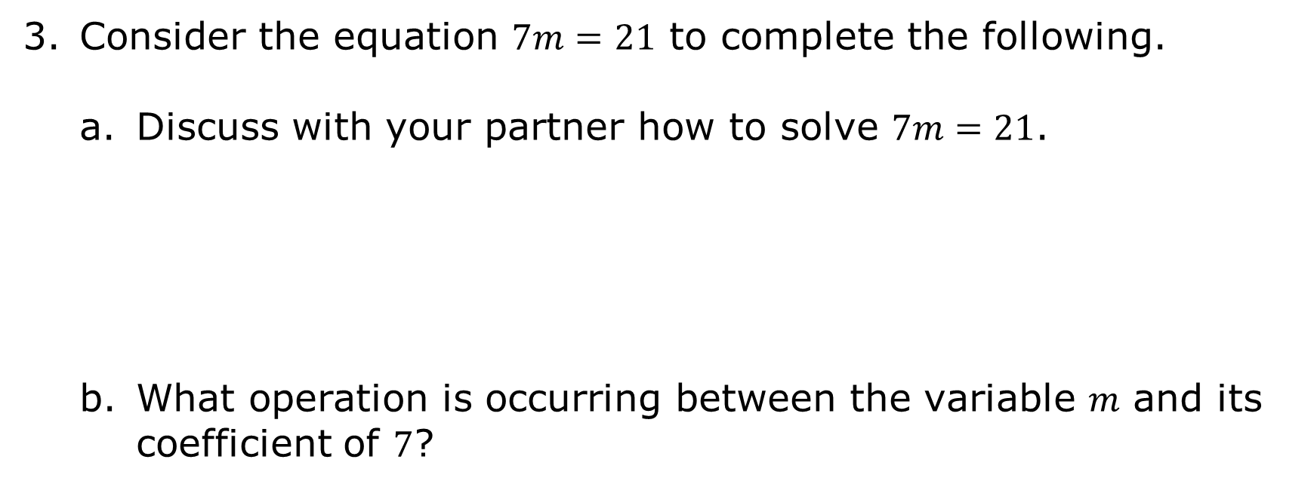
Consider the equation $7m=21$ to complete the following.
Discuss with your partner how to solve $7m=21$.
What operation is occurring between the variable 𝑚 and its coefficient of $7$?
volume 2, pg. 347

Slide 12
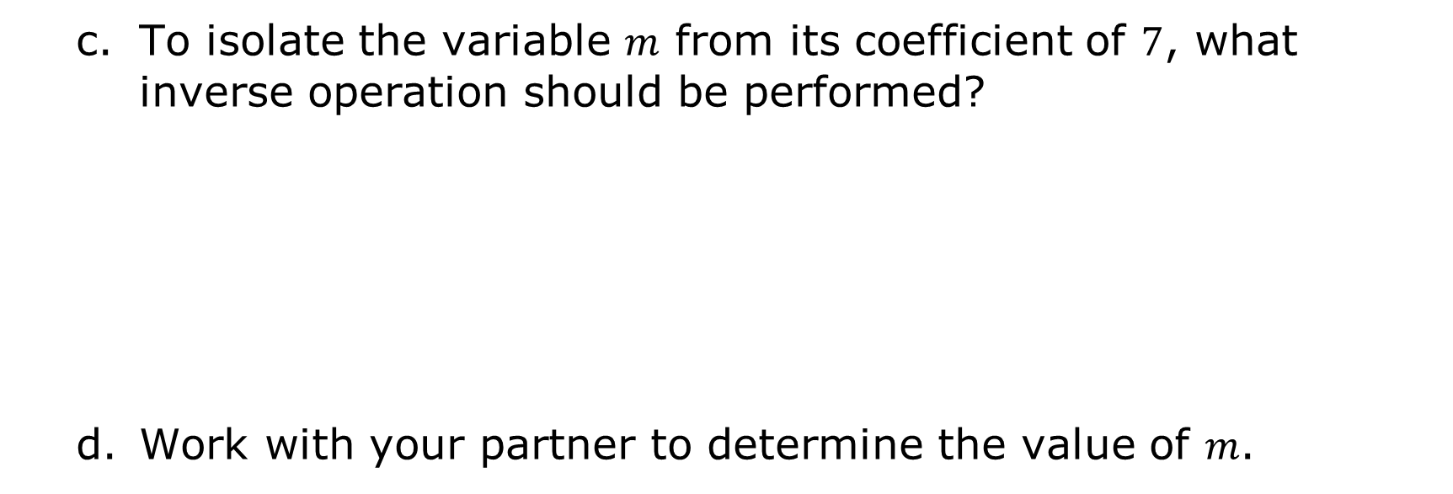
To isolate the variable 𝑚 from its coefficient of $7$, what inverse operation should be performed?
Work with your partner to determine the value of 𝑚.
volume 2, pg. 347

Slide 13
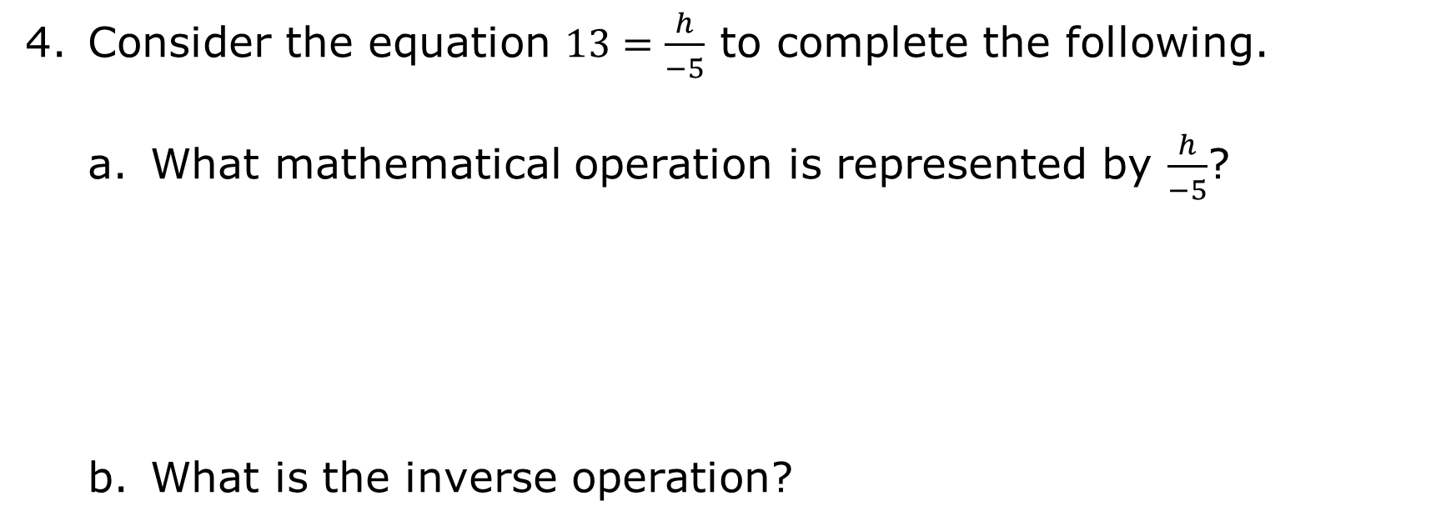
Consider the equation $13=\frac{h}{−5}$ to complete the following.
What mathematical operation is represented by $\frac{h}{−5}$?
What is the inverse operation?
volume 2, pg. 348

Slide 14

Perform the inverse operation in the boxes below.
$$(13)=\left(\frac{h}{−5}\right)$$
What is the value of ℎ?
Discuss with your partner how to check whether or not your solution is correct. Then, check your solution.
volume 2, pg. 348

Slide 15

Guided Practice
volume 2, pg. 348

Slide 16

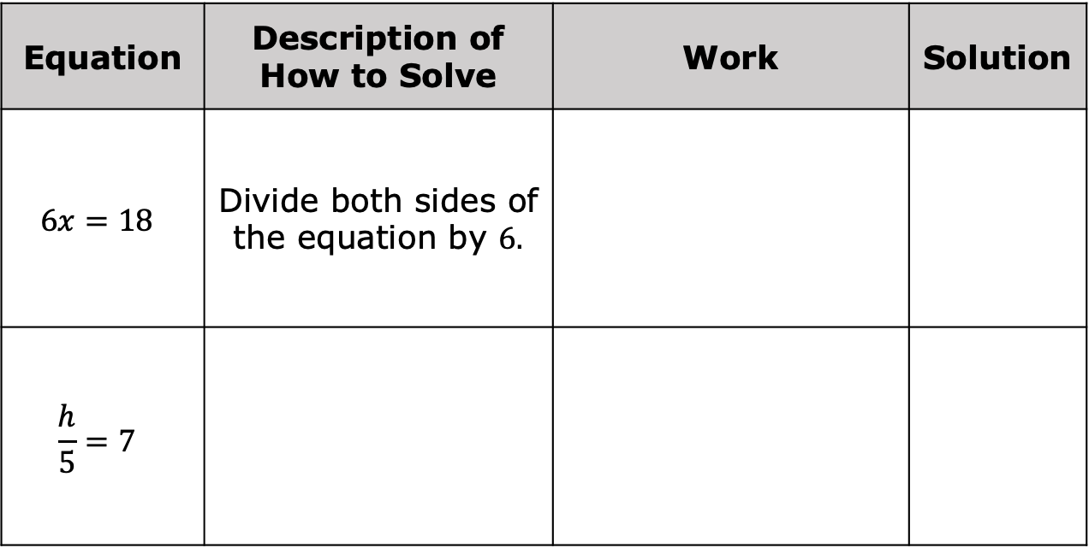
12.12.3 Guided Practice: Solving One-Step Multiplication and Division Equations Algebraically
Complete the table.
Equation | Description of How to Solve | Work | Solution
$$6x=18$$ | Divide both sides of the equation by $6.$
$$\frac{h}{5}=7$$
volume 2, pg. 348

Slide 17
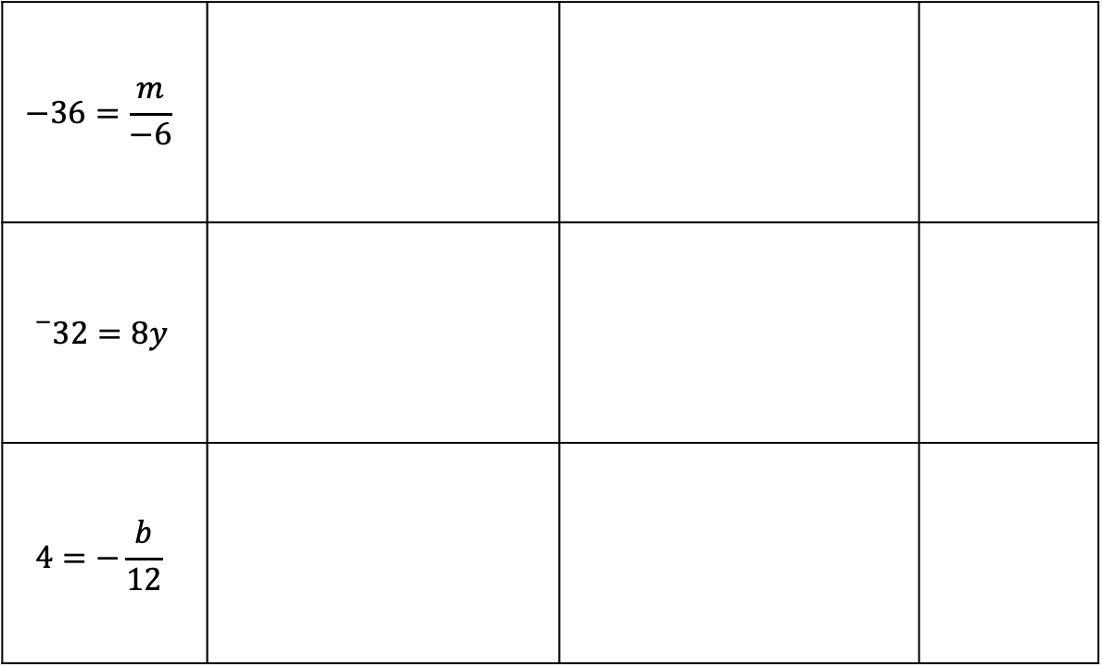
$$−36=\frac{m}{−6}$$
$${}_{}^{−}{32}=8y$$
$$4=−\frac{b}{12}$$
volume 2, pg. 348

Slide 18
With your partner, verify each solution is correct using substitution.
volume 2, pg. 349

Slide 19

Your Turn
volume 2, pg. 349

Slide 20

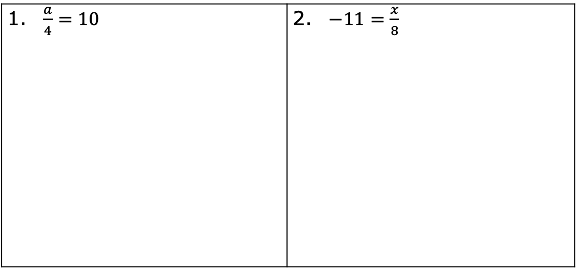
12.12.4 Your Turn!
Solve each equation algebraically. Show your work.
$\frac{a}{4}=10$ | $−11=\frac{x}{8}$
volume 2, pg. 349

Slide 21
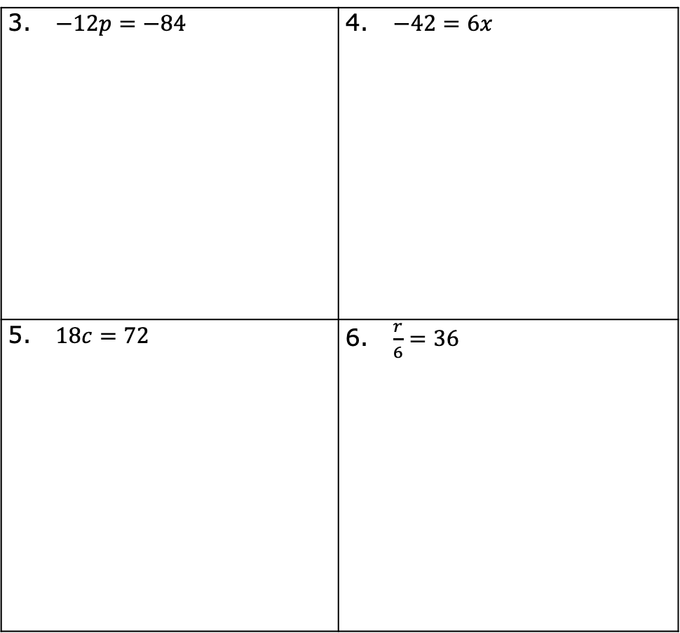
$−12p=−84$ | $−42=6x$
$18c=72$ | $\frac{r}{6}=36$
volume 2, pg. 349

Slide 22

Wrap-Up
volume 2, pg. 350

Slide 23
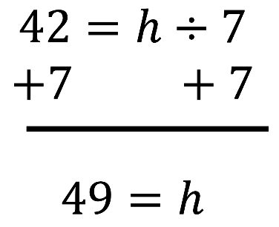
12.12.5 Wrap-Up: Error Analysis
While checking her homework from last night, Lola noticed she got the following problem incorrect. Examine Lola’s work and write a note to her detailing how she can correct her mistake.
volume 2, pg. 350

